Slide 1
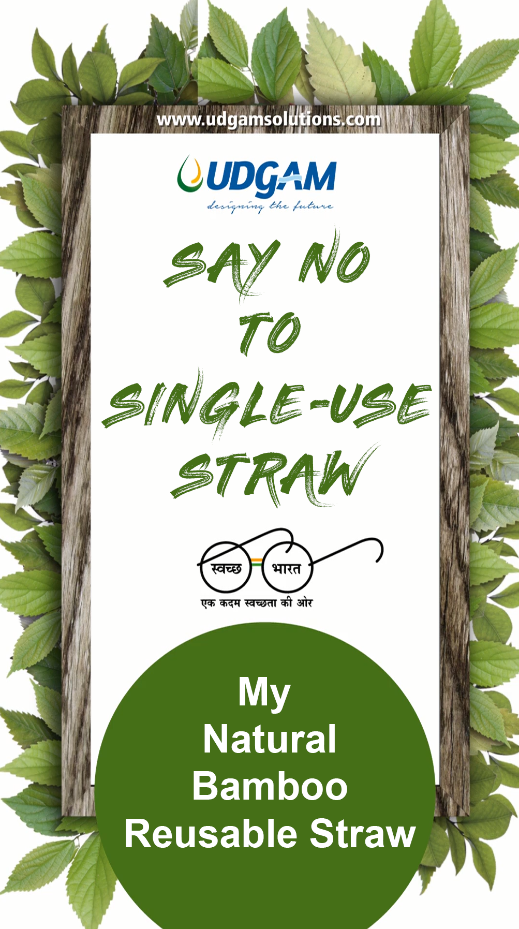
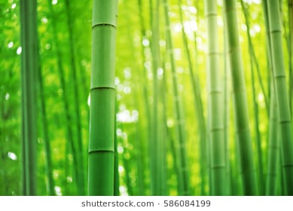
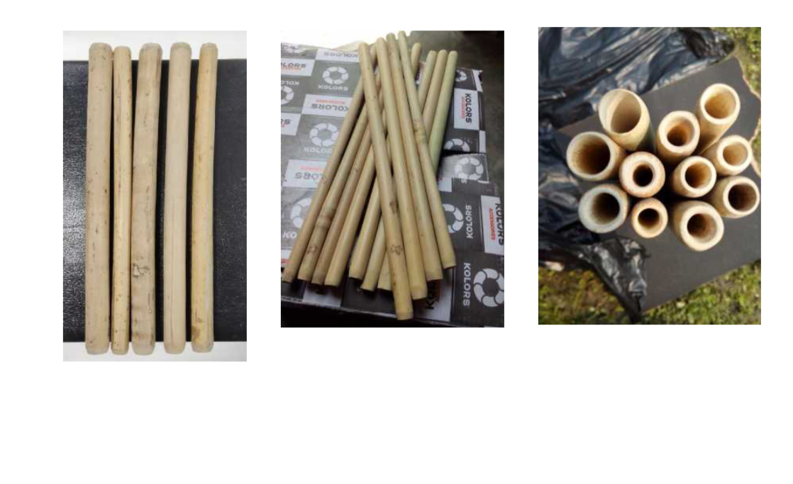
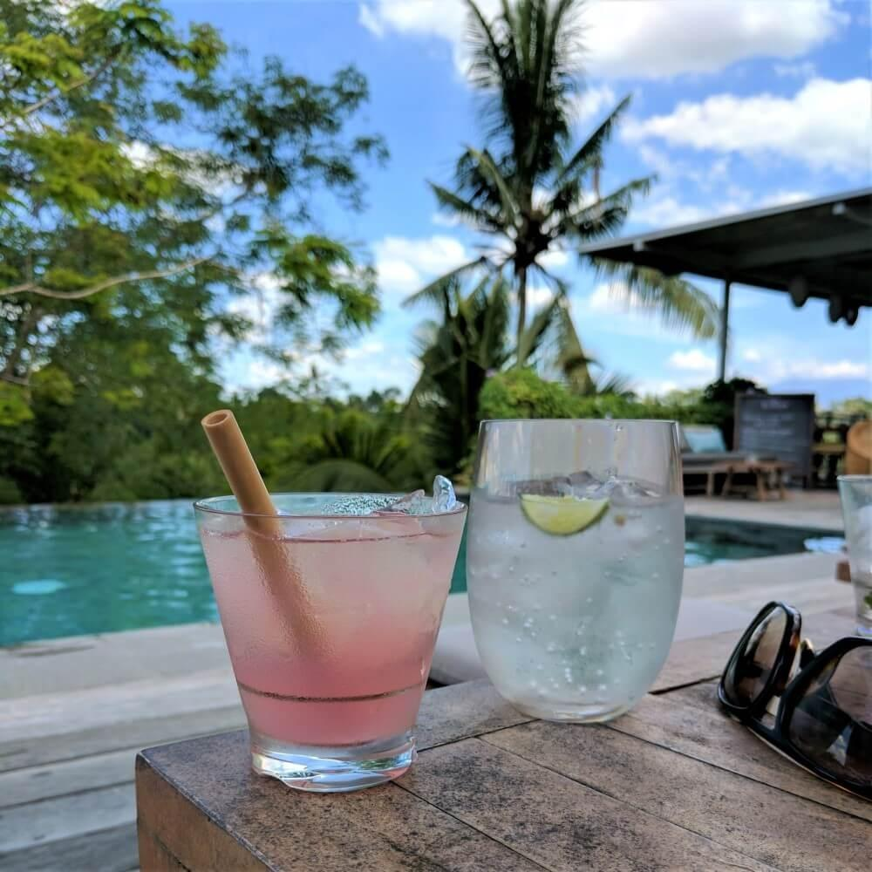
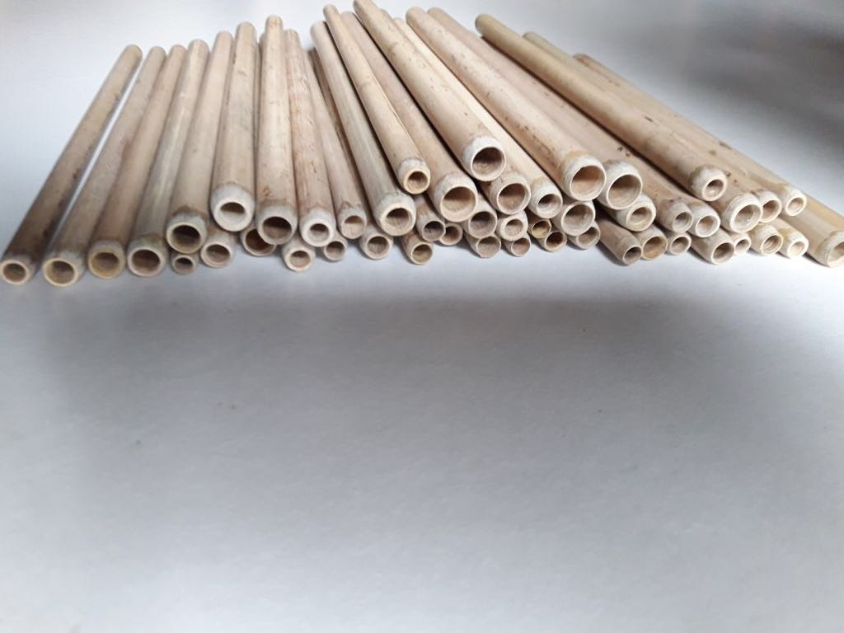
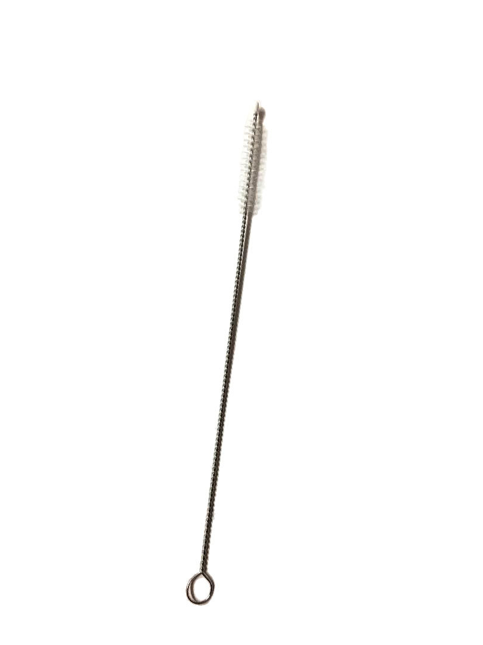
100 % Natural & Eco Friendly Reusable Bamboo Straws with protective skin
Organic.
Sanitized.
Odourless
No Dye.
No Colour
Non-toxic.
Long lasting
Beveled edges
Pack of 12 /15
including 1 cleaning brush
www.udgamsolutions.com
info@udgamsolutions.com

Slide 2
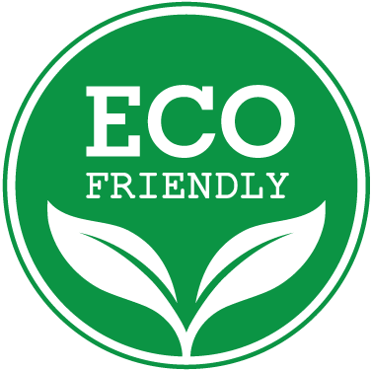
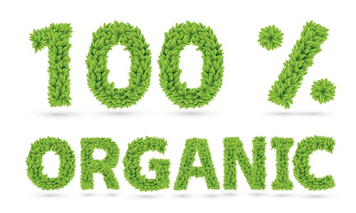
100 % Natural & Eco Friendly Reusable Bamboo Straws
Millions of plastic straws are used all across the globe every single day. The scary part is: “If you were to connect all those straws together, they would measure two and a half times the circumference of the Earth” as these are not recycled. Plastic straws do not break down easily and either settle down at one place for years or, if they get in our waterways, ends up in our marine life.
At Udgam we quickly realise that before we could effectively help people reduce their plastic consumption, we must get non-plastic alternatives to replace plastic which is used every-day.
Here is yet another introduction by Udgam which is 100%.
The drinking straws are 100% handmade from real whole bamboo stalks – nothing re-compressed or processed. They are washable and reusable. These are grown in India and crafted by locals. Are light in weight, durable and of course biodegradable.
Soon after finishing these straws are treated with a blend of Azadirachta indica (Commonly called as Neem) and salt.
It is extremely easy to clean the straws and most common ways are : handwash with luke warm water, dis-infect in hot water after adding some vinegar and so many other ways to make them sanitized and odourless. We provide a Pipe cleaner with every pack. Stop buying toxic and polluting plastic straws again.
Treated with natural and food-grade elements
Comes in two size groups: 8-10 mm external diameter and 10-13 mm external diameter.
Standard lengths available are 6, 8, and 10 inches

